Slide 1
Slaviša Đurđić
Startup Venture Funding
Goal: Analysis of the Tableau “Startup Venture Funding” technology data sample dataset with Looker Studio.
Instructions:
- Collect data by downloading the Excel file from https://public.tableau.com/app/learn/sample-data?qt-overview_resources=1#qt-overview_resources.
- Connect to the file from Looker Studio and build visuals (https://lookerstudio.google.com/reporting/5249a68f-00f7-4571-9949-28d3952c1060/page/Kr7eD).
Belgrade, October 2023

Slide 2
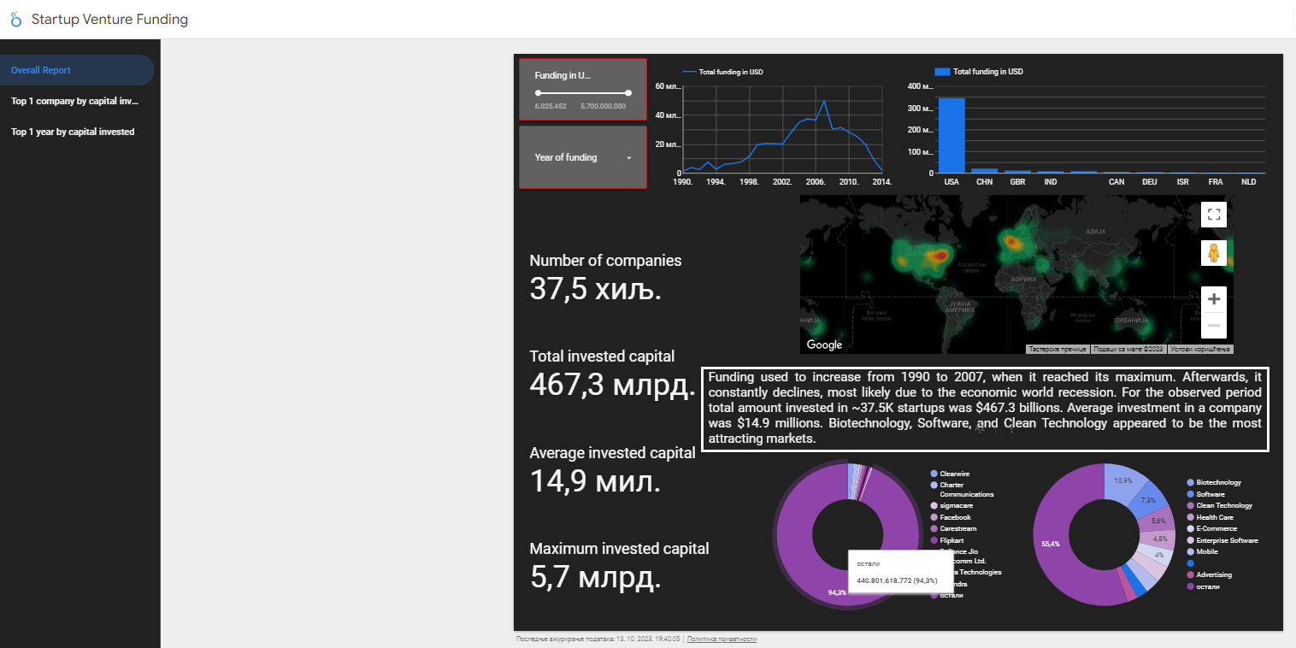

Slide 3
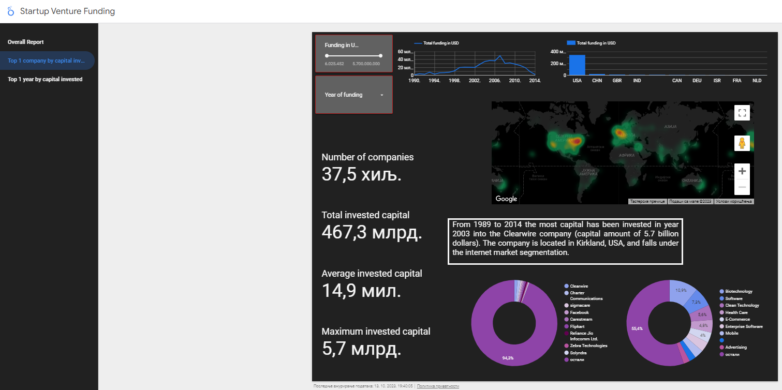

Slide 4
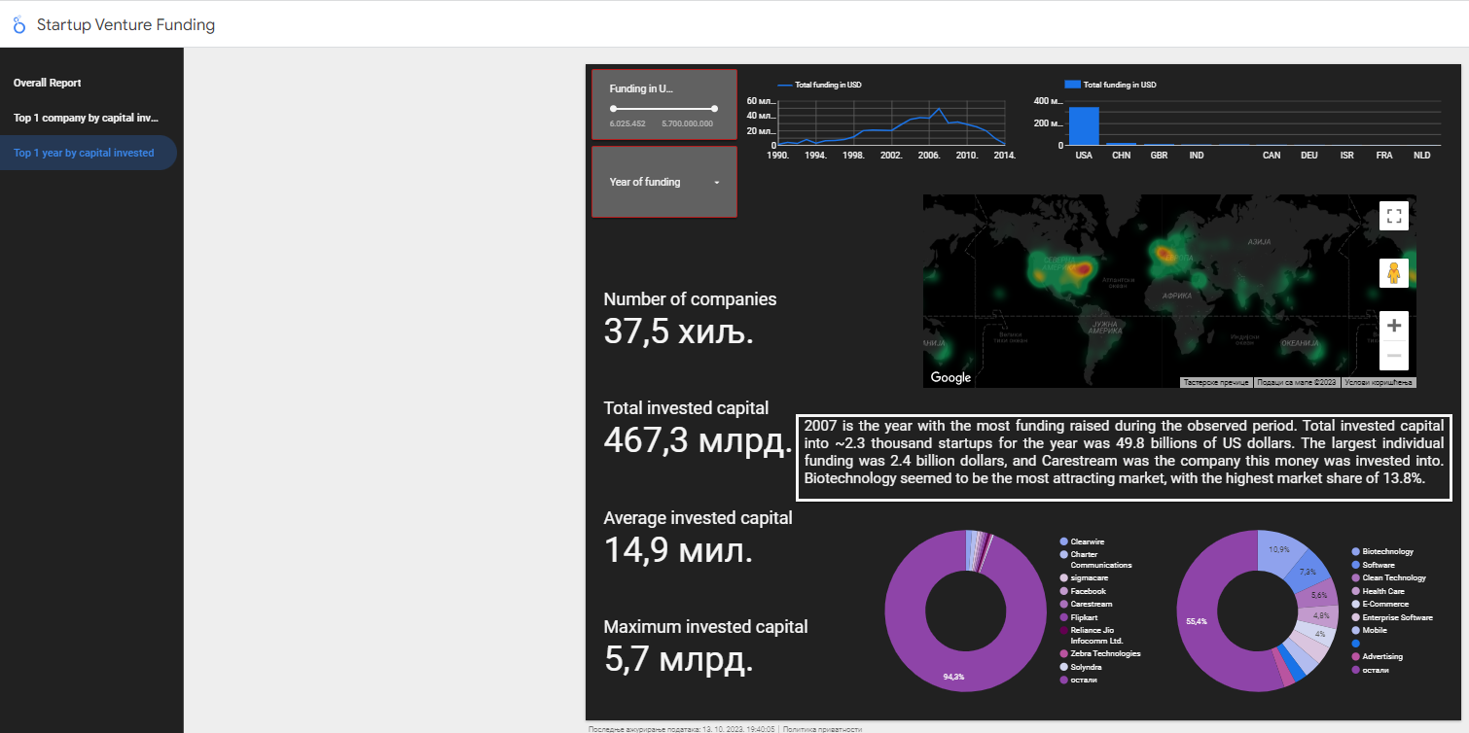

Slide 5
Startup Venture Funding Project Insights
Funding used to increase from 1990 to 2007, when it reached its maximum. Afterwards, it constantly declines, most likely due to the economic world recession. For the observed period total amount invested in ~37.5K startups was $467.3 billions. Average investment in a company was $14.9 millions. Biotechnology, Software, and Clean Technology appeared to be the most attracting markets.
From 1989 to 2014 the most capital has been invested in year 2003 into the Clearwire company (capital amount of 5.7 billion dollars). The company is located in Kirkland, USA, and falls under the internet market segmentation.
2007 is the year with the most funding raised during the observed period. Total invested capital into ~2.3 thousand startups for the year was 49.8 billions of US dollars. The largest individual funding was 2.4 billion dollars, and Carestream was the company this money was invested into. Biotechnology seemed to be the most attracting market, with the highest market share of 13.8%.

